Slide 1




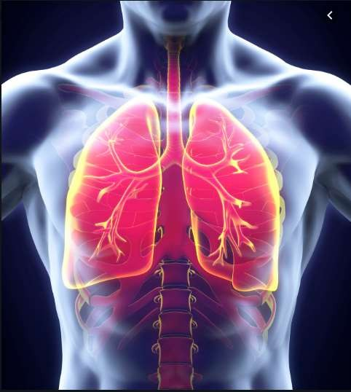



Diagnosing Pneumonia
from Chest X-Rays using
Computer Vision
Great Learning Capstone Project
◆ Group 5B
◆ Ryan Reddy Mobile: 9820149058 Email: ryanreddy93@homtail.com
Basavaraj Krishnappanavar Mobile: 8867389693 Email : bskrish757@gmail.com

Slide 2




Contents
Introduction
Problem Statement
Problem Benefit
R e s u l t s

Slide 3




Radiology is a branch of medicine where the disease is diagnosed by examining X-ray images of the chest.
To reduce the human eye error in diagnosing the disease computer aided system has evolved for better diagnosis.
Introduction
Artificial Intelligence & Machine learning techniques has shown remarkable growth and results in the recent years.
In this project we are trying to diagnose Pneumonia infection from chest X-ray using Artificial Intelligence & Machine Learning techniques through Computer Vision.

Slide 4





Problem
◆ Pneumonia is an infection in one or both lungs. Bacteria, viruses, and fungi cause it. The infection causes inflammation in the air sacs in your lungs, which are called alveoli.
◆ Pneumonia accounts for a large number of deaths amongst children Internationally. It is detected through a medical process called chest radiography (CXR). This process is complex in the medical world due to numerous other lung conditions along with pneumonia hence not providing accurate results. The process is even more challenging as it has to be handled by only highly trained specialist medical advisors.
◆ Due to this complexity, we would need to devise and automate an algorithm around detecting pneumonia, through bounding boxes in-order to help physicians make better decisions or even replace human judgement.
Statement

Slide 5
Problem
◆ We would need to treat the respective data to develop an automated machine learning model, inorder to help medical advisors take quicker decisions/actions in treating patients as well as reducing the overall death rate.
◆ Pneumonia accounts for over 15% of all deaths of children under 5 years old internationally. In 2017, where 920,000 children under the age of 5 died from the disease. We foresee our study via building a computer vision algorithm.
Statement

Slide 6
Problem
With an advance in technology that Artificial Intelligence and Machine Learning bring, it will help medical advisors detect pneumonia in patients easily by building an algorithm using computer vision. Hence helping medical advisors to detect and treat patients quicker with an automated process in place, thereby curbing human error rate.
Benefit

Slide 7



Images were trained on various architectures inorder to derive the best possible accuracies, hence smoothing the process for medical advisors.
Images were trained for a multiple bounding box output.
Results
The most effective and efficient was the basic UNet TL Model giving us an Accuracy : 86.66% & IoU : 0.37.
In comparison to the Real Target, UNet’s TL Model gave us the best result with a higher IoU & Accuracy in comparison to other trained models.

Slide 8
We would like to express our sincere gratitude
to Mr. Akshay for his mentorship and
Acknowledgement
guidance.

